Slide 1
Unlocking Digital Transformation With APIGEE
Nov 10, 2020, Utrecht, Kapil Dwivedi

Slide 2

Introduction
Kapil Dwivedi
API Management & AWS Solution Architect
Enabling Digital Transformation via adoption of an API First strategy and Ensuring Customer
success with the API Management Platform like APIGEE and Mashery.
Primary focus on API lifecycle and Designing Integration Solution around it.
https://www.linkedin.com/in/kapildwivedi/

Slide 3
Agenda
Digital Transformation and Power of API’s
API Management Platform - APIGEE
APIGEE Product and Offerings
API Components and Deployment Models
API lifecycle
Demo : Real Time Use case

Slide 4

Digital Transformation – Go Digital or Go Bust
Digital transformation is the process of using digital technologies to create new — or modify existing — business processes, culture, and customer experiences to meet changing business and market requirements. This reimagining of business in the digital age is digital transformation.

Slide 5
Digital Transformation Cont... How APIs Drive Innovation through Customer Centricity
Strategy
Execution
Result
Customer Centricity
Using API’s for every step in the Customer Journey
API’s drive Innovation
Fast time to market enhance customer experience
opening new partner opportunities

Slide 6
Power of API’s - Connectivity Benchmark Report
What business results has your organization realized from leveraging APIs?
What percentage of your organization's revenue is generated from APIsand API-related implementations?
Increased productivity - 58%
Increased innovation - 48%
Increased employee engagement - 43%
Increased speed in meeting LoB demands - 35%
Greater agility across teams to self-serve IT - 35
Decreased operational costs – 34%
Experienced revenue growth as a direct result- 31%
Too early to say – 7 %
None of these - 1%
0% of revenue - 10%
1-10% of revenue – 15%
11-25% of revenue – 35%
26-50% of revenue – 24 %
51-75% of revenue – 9%
76-100% of revenue – 2%
Don't know – 5%

Slide 7
Questions Unanswered
Developer Engagement
Security
Two Speed IT
Analytics

Slide 8
Agenda
Digital Transformation and Power of API’s
API Management Platform - APIGEE
APIGEE Product and Offerings
API Components and Deployment Models
API lifecycle
Demo : Real Time Use case

Slide 9
What is API Management
API management is the process of creating and publishing web APIs, enforcing their usage policies, controlling access and Security, nurturing the subscriber community, collecting and analyzing usage statistics, and reporting on performance

Slide 10
APIGEE Products
APIGEE Edge
APIGEE Sense
APIGEE Monitization

Slide 11
Agenda
Digital Transformation and Power of API’s
API Management Platform - APIGEE
APIGEE Product and Offerings
API Components and Deployment Models
API lifecycle
Demo : Real Time Use case

Slide 12
APIGEE Edge offerings
1
APP Developer Services
2
API Gateway Services
3
Analytics services

Slide 13
APP Developer Services
Developer Portal & Documentation
Developer On boarding (Self Service)- User/RBAC/ App/Key Management
API product, Discovery & Subscriptions
Developer evangelism, Community Collaboration
Monetization, Client SDK, Developer Support

Slide 14
API Gateway Service
Architecting API Ecosystem
Defining solutions for API based integration
Subscription analysis, Contract negotiations and Cost control
Enforcing API design standards, Governance, and best practices
Configuration of API’s proxies, programmability.
Develop & Maintain the "template" API Proxy
Ensuring end to end API Security, Audit and logging
CICD for Proxy Deployments & Automation
Custom Development

Slide 15
Analytics Services
Developer Analytics, Ops and Business metrics, App performance
High Availability,Fault tolrence,Disaster Recovery Planning
Hybrid and On Premise infra, Health checks, Server life cycle Management
Capacity planning
PAAS Platform Uptime, Compliance

Slide 16
Agenda
Digital Transformation and Power of API’s
API Management Platform - APIGEE
APIGEE Product and Offerings
API Components and Deployment Models
API lifecycle
Demo : Real Time Use case

Slide 17
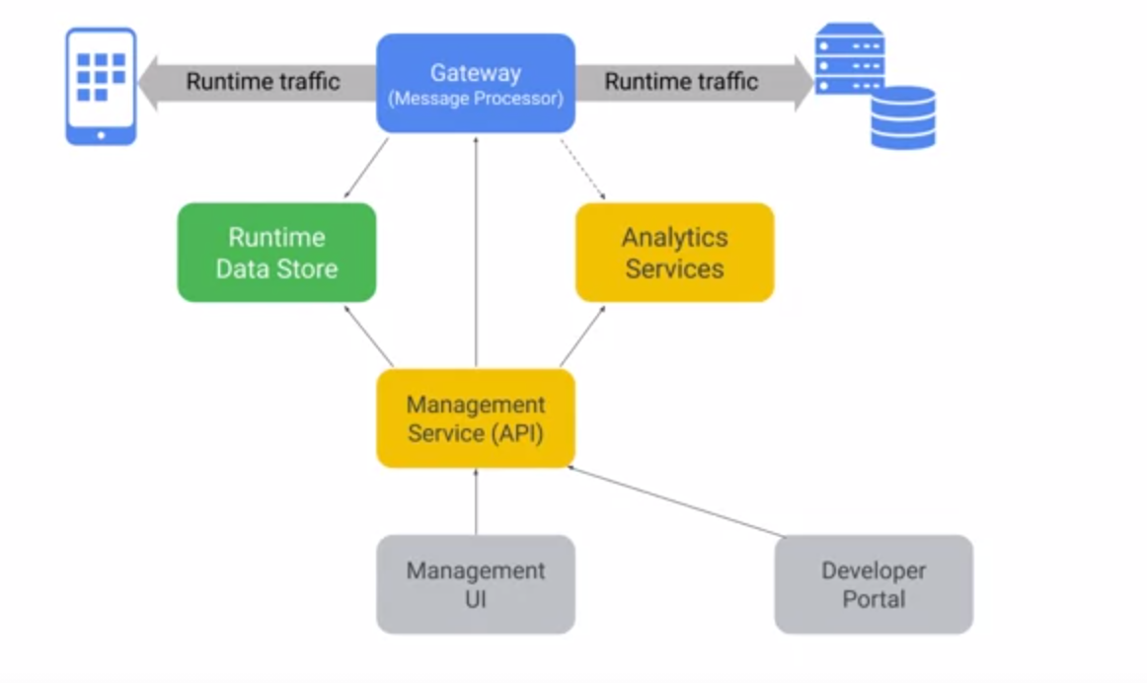
APIGEE COMPONENTS

Slide 18
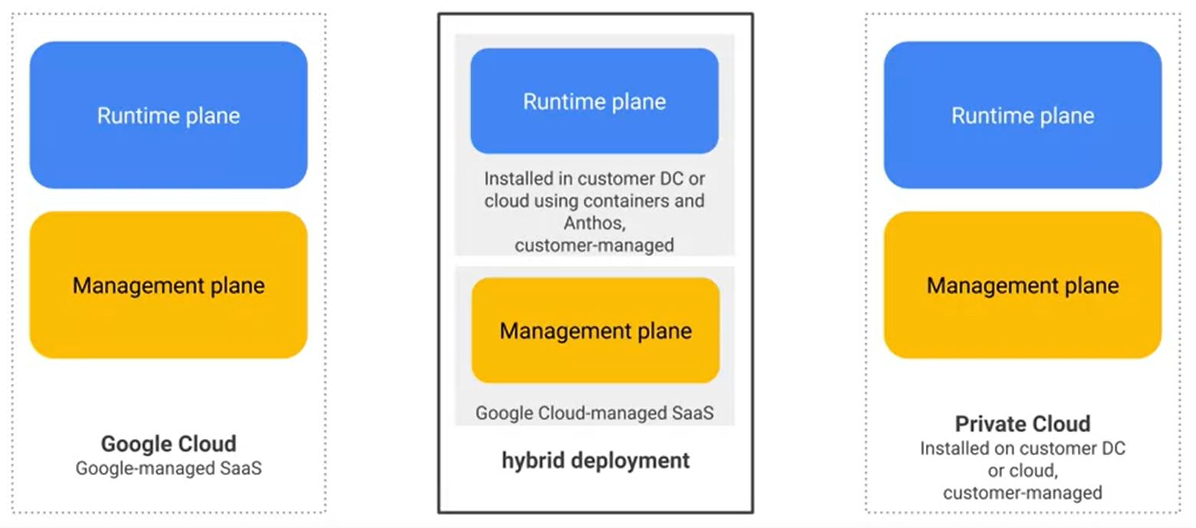
Flexible Deployment Models

Slide 19
API Management Platform Architecture
Application Lifecycle Management
GIT
Jenkins
Maven
SonarQube
Junit
Jmeter
B2C
APIGEE
API Management Platform
Hybrid Cloud Offering
Analytics
Monetization
Anthos
APIGEE
Gateway
(api proxy)
API Security
B2B
API’s
API’s
http/https
API’s
http/https
Legacy/backend
B2E
API Products
Developerportal, Forums,Blogs
API Mangement Portal, Monitoring
Applications
Developers
Internal users

Slide 20
Agenda
Digital Transformation and Power of API’s
API Management Platform - APIGEE
APIGEE Product and Offerings
API Components and Deployment Models
API lifecycle
Demo : Real Time Use case

Slide 21
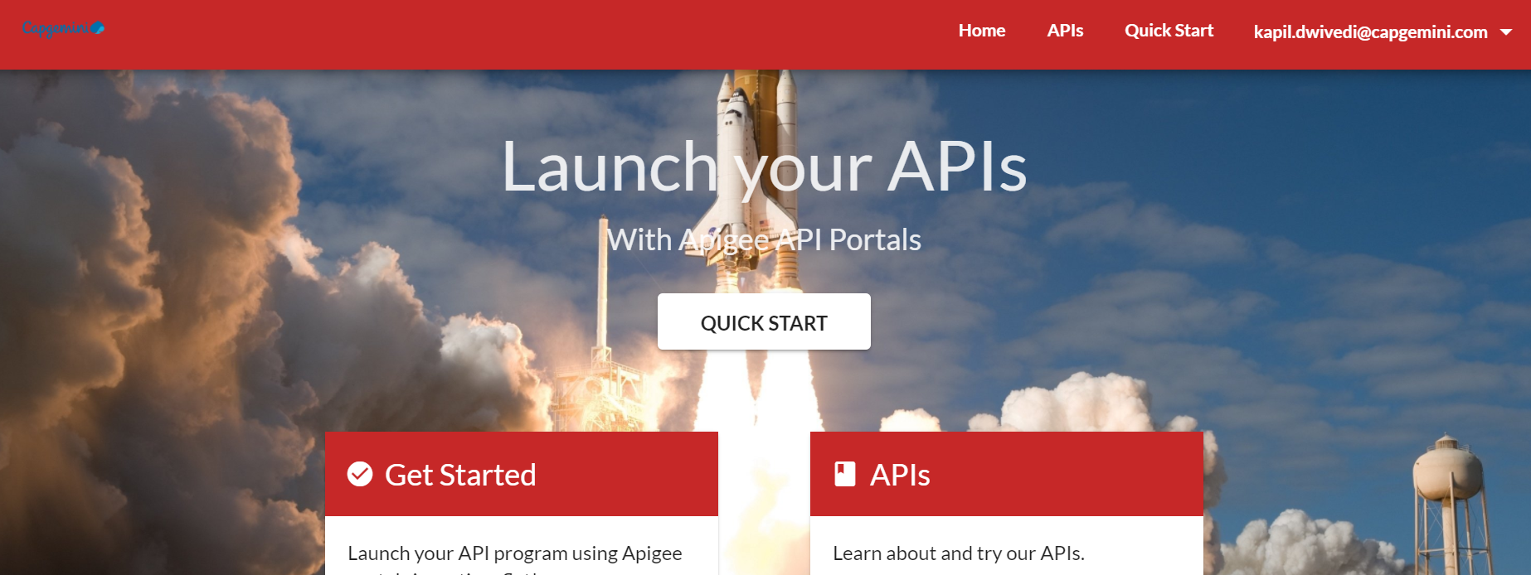
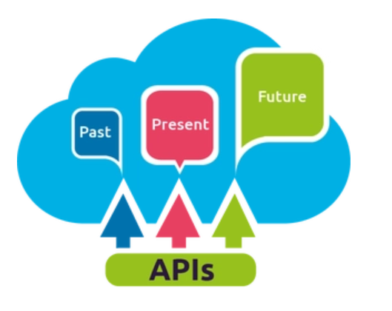
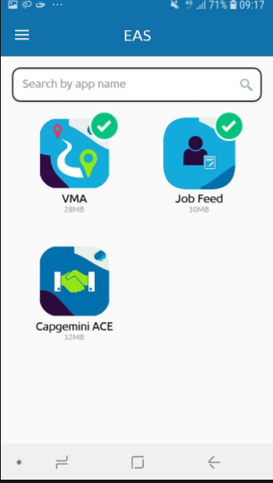


Real Time Use case
Developer Portal
Step 5 –
Register an app at developer portal
Step 3 - Create API Product
Step 1
Step 2 –
Build API Proxy
Step 6 - Request for weather
data with API key or token
Validate the request
Step 4-Mobile Client
Transformation if
required
Logging
Step 7

Slide 22
API Life Cycle
Monitze
Analyze
Monitor
Scale
Publish
Security
Develop
Design
Design
Develop
Secure
Publish
Scale
Monitoring & Analytics
Monitze
Community
APIs
Management

Slide 23
Agenda
Design
Develop
Secure
Publish
Scale
Monitoring & Analytics
Monitze

Slide 24
API Design
Naming Convention
Complexity
Response
Versioning
HATEOAS
KISS
Use nouns and NOT the verbs, Use of right HTTP methods
Use Plurals
Use parameter –
products?name=’ABC’ should be preffered over /getProductsByName
Use Pagination
/products?limit =25&offset = 50
give link to previous and next page for the information
Proper error codes
2xx
3xx
4xx
5xx
Use Proper Error Messages
Send co-relation id or message ID to trace back
URI versioning
Query String Versioning
Header Versioning
Media type versioning
Enable navigation to related resources
https://xyz.com/orders/3
{
"orderID":3,
"productID":2,
"quantity":4,
"orderValue":16.60,
}

Slide 25
Agenda
Design
Develop
Secure
Publish
Scale
Monitor & Analyze
Monitze

Slide 26
Develop
Traffic Management
Mediation
Quota
Splike Rest
Response cache
Lookup cache
Populate cache
Reset Quota
JSON To XML
XML to JSON
Raise fault
XSL Transformation
SOAP Message validation
Assign message
Extract variable
Access entity
Key Value Map Operation

Slide 27
Develop
Security
Extension
Java Callout
Python
Java script
Service call out
Statistics collector
Message Logging
XML Threat Protection
JSON Threat Protection
Regular Expression Protection
OAuth2.0
Get OAuth2.0 info
OAuth1.0
Verify API key
Access control
Generate SAML Asseration
Validate SAML Asseration

Slide 28
Agenda
Design
Develop
Secure
Publish
Scale
Monitor & Analyze
Monitze

Slide 29
Security in Digital Value chain
User - OAuth 2.0,MFA, Fedrated login, IP Access control
APP - API key, OAuth 2.0, Mutual TLS
Developer – RBAC, SSO
API - Threat Protection, OAuth 2.0, Quota, Bot detction
API Team - RBAC,LDAP Audit.
Backend - Mutual TLS, Southbond VPN and IP Access control

Slide 30
Agenda
Design
Develop
Secure
Publish
Scale
Monitor & Analyze
Monitze

Slide 31
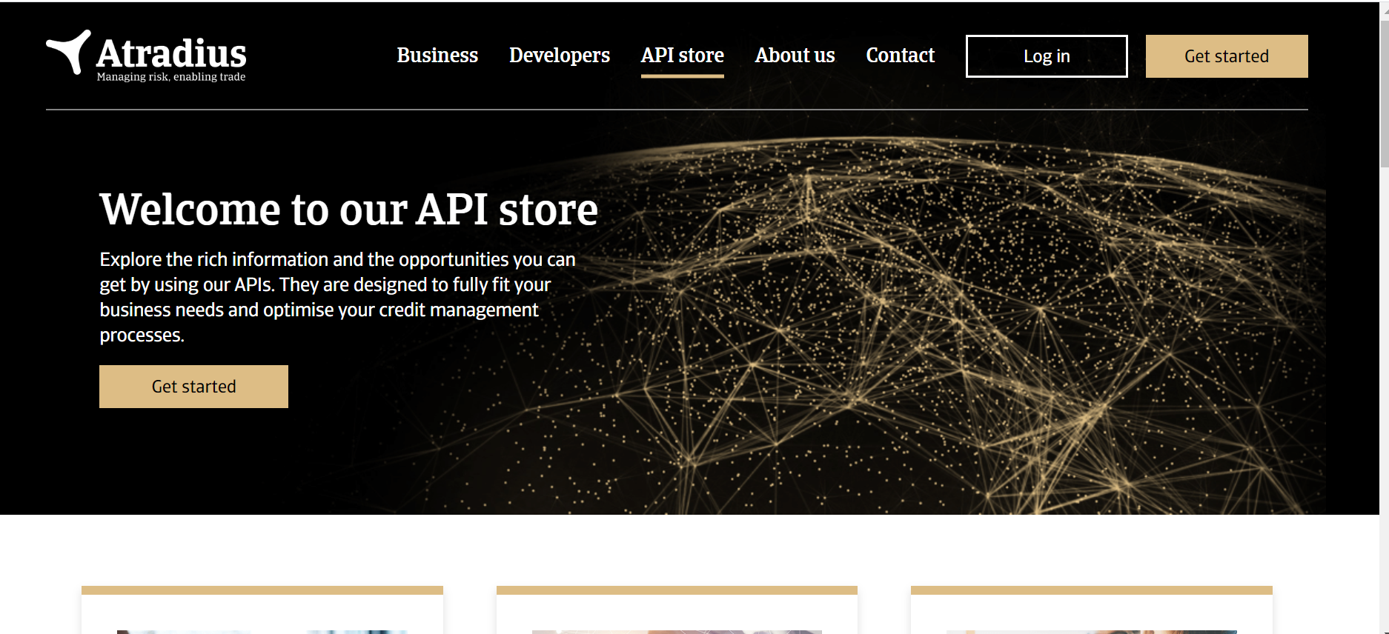
Publish – Developer portal
• Registration and key credentialing
• Documentation
• Support channels
• Blogs and forums
• SDKs and other resources
• App Gallery for inspiration
• Value Prop and Terms of Service

Slide 32
Agenda
Design
Develop
Secure
Publish
Scale
Monitoring & Analytics
Monitze

Slide 33
Monitoring
Dev App Issue
Platform Issue
Backend Issues
Proxy and Policiy issue
Traffic Drops/Spikes
Increase error rates
Proxy Error
Latencies
Proxy callout Error
Faults
Gateway Errors
Deployment Issues
Target errors
Latencies

Slide 34
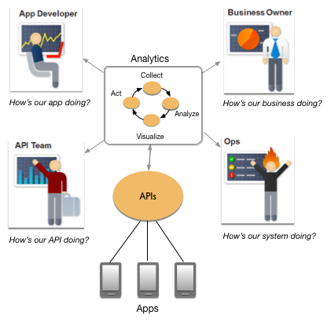
Analytics
Response time
Request latency
Request size
Target errors
API Consumption Assessment
Insufficient data center capacity

Slide 35
Agenda
Design
Develop
Secure
Publish
Scale
Monitor & Analyze
Monitze

Slide 36
Monitzation
Various revenue models
Payment and billing capabilities
Flexible reporting
Developer portal Integration

Slide 37
Agenda
Design
Develop
Secure
Publish
Scale
Monitor & Analyze
CI & CD

Slide 38
API Proxy Template
API Name
Proxy revision
The inbound and outbound target path
HTTP Operations
Security Details
CROS configuration
Traffic management policies
Transformation policies
Mediation policies
Cache policies
Extension policies
Plan Name and their associated services
Communication details

Slide 39
CI and CD Cycle
Development Team
Source Code in version control
Build Process triggered
Code Qulaity analysis and unit test
Deploy API bundle
Functaional Test or performace Test
Publish the Reports
Update the Docs

Slide 40
Tools involved in CI and CD Process
GitHub, Bitbucket
Build
Bamboo, jenkins.
Code quality analysis and Unit testing
Jslint,Sonar, apifortress
Deploy API Proxy
Xl Deploy, jenkins
Functional test & Performace Test.
Postman, Gatling
Update Docs
Developer portal, Confluence
Source Code

Slide 41
CI and CD Step by Step
Build an API Proxy bundle and pushed into GitHub or another version control system.
An automatic build pipeline will be triggered by Bamboo or Jenkins can be used.
Static Code Analysis and unit test Jobs should be part of build pipeline tools like sonar, apifortress can be used.
Deploy artifacts i.e. API Proxy in respective environments like test, QA and prod. Tool wise Xl deploy and Jenkins can be good options.
Functional test and Performance Test can be performed with postman and Gatling respectively.
At the last step, we should update the documents in developer portal and if there any other documentation like confluence.

